Slide 1
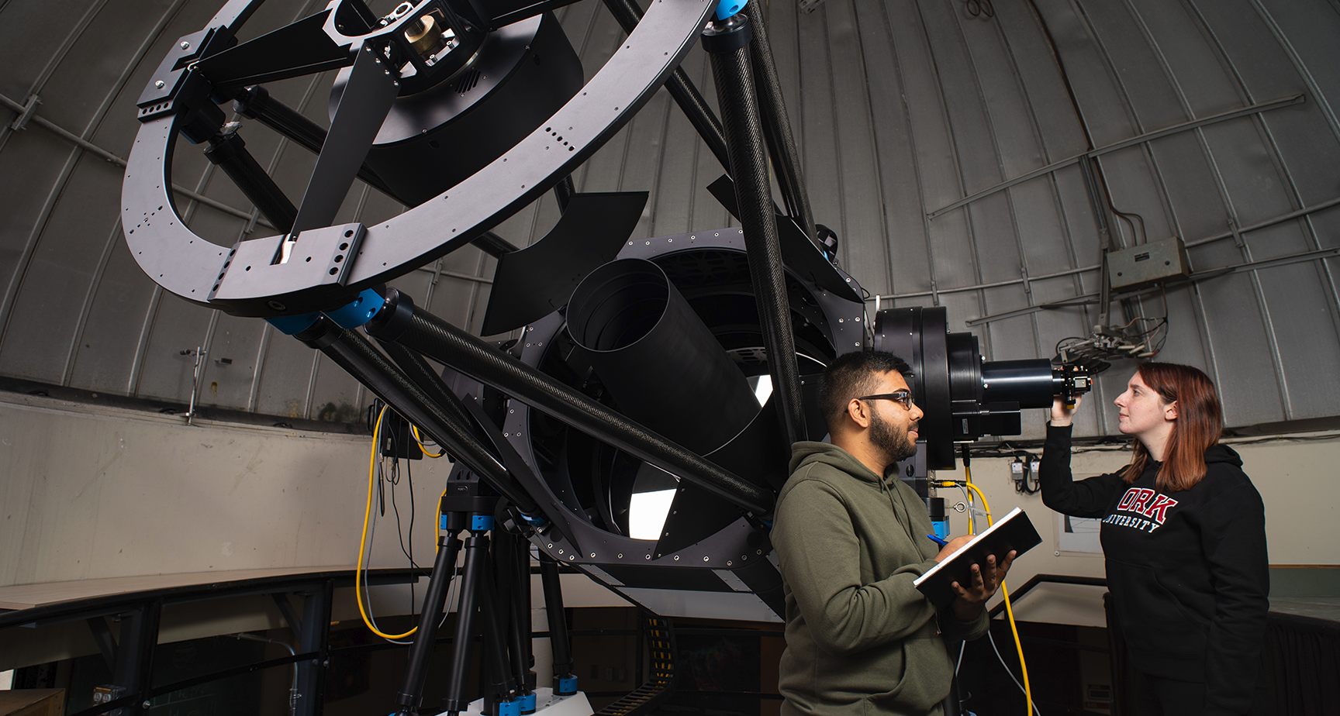
EARTH & ATMOSPHERIC SCIENCE
CURRICULUM UPDATES

Slide 2
EARTH AND ATMOSPHERIC SCIENCE – ORDINARY 90 CR BSC
NEW
Important Update: EECS 2501 1.00 Fortran and Scientific Computing: EECS 2501 1.00 (Fortran and Scientific Computing) is no longer required for the Earth and Atmospheric Science program. If enrolled: Students may drop the course for 2025–2026 without affecting degree progress. Drop, withdrawal, and refund deadlines apply. If completed: The course will still count toward total credits and overall GPA (OCGPA). Optional: Students may stay enrolled if they wish. Petition option: If the course grade negatively affects GPA, students may petition to drop it—instructions are available via the Lassonde Petitions website.

Slide 3
EARTH AND ATMOSPHERIC SCIENCE – ORDINARY 90 CR BSC
UPDATED
Effective Fall 2022 and regarding the below Academic Calendars: 2017-2018 Academic Calendar 2018-2019 Academic Calendar 2019-2020 Academic Calendar 2020-2021 Academic Calendar 2021-2022 Academic Calendar Where ESSE 2011 3.00 and ESSE 2012 3.00 are listed among the degree requirements, please see the below pre-approved course substitutions.
Scenario | ESSE 2011 | ESSE 2012 | Remediation
1 | Passed | Passed | No remediation required
2 | Passed | Failed or didn’t take | Take ESSE 2010 3.00
3 | Failed or didn’t take | Passed | Complete one of the following courses: ESSE 2020 3.00, ESSE 3XXX 3.00, ESSE 4XXX 3.00, MATH 3241 3.00, or PHYS 2060 3.00
4 | Failed or didn’t take | Failed or didn’t take | Take ESSE 2010 3.00 and ESSE 2020 3.00

Slide 4
EARTH AND ATMOSPHERIC SCIENCE – ORDINARY 90 CR BSC
UPDATED
Up to Summer 2022 and regarding the below Academic Calendars: 2016-2017 Academic Calendars and prior Where ESSE 2010 3.00, CHEM 1000 3.00, and CHEM 1001 3.00 are listed among the degree requirements, please see the below pre-approved course substitutions.
Scenario | ESSE 2010 | CHEM 1000 | CHEM 1001 | Remediation
1 | Passed | Failed or didn’t take | Failed or didn’t take | Take CHEM 1000 and CHEM 1001
2 | Failed or didn’t take | Failed or didn’t take | Failed or didn’t take | Take ESSE 2011 and ESSE 2012 and Take CHEM 1000 or CHEM 1001
3 | Failed or didn’t take | Passed | Failed or didn’t take | Take ESSE 2011 and ESSE 2012
4 | Failed or didn’t take | Failed or didn’t take | Passed | Take ESSE 2011 and ESSE 2012
5 | Failed or didn’t take | Passed | Passed | Consult Undergraduate Program Director and Academic Advisor to determine which of ESSE 2011 or ESSE 2012 should be completed.
ESSE 2011 and ESSE 2012 have since been discontinued. For students still requiring ESSE 2011 or ESSE 2012, refer to the previous slide.

Slide 5
EARTH AND ATMOSPHERIC SCIENCE – ORDINARY 90 CR BSC
RECAP
Course substitution: MATH 2930 3.00 may be completed instead of MATH 2565 3.00
Foundational Science (6.00 credits): PHYS 1010 6.00 or both of PHYS 1011 3.00 and PHYS 1012 3.00

Slide 6
EARTH AND ATMOSPHERIC SCIENCE – ATMOSPHERIC SCIENCE
UPDATED
Effective Fall 2022 and regarding the below Academic Calendars: 2017-2018 Academic Calendar 2018-2019 Academic Calendar 2019-2020 Academic Calendar 2020-2021 Academic Calendar 2021-2022 Academic Calendar Where ESSE 2011 3.00 and ESSE 2012 3.00 are listed among the degree requirements, please see the below pre-approved course substitutions.
Scenario | ESSE 2011 | ESSE 2012 | Remediation
1 | Passed | Passed | No remediation required
2 | Passed | Failed or didn’t take | Take ESSE 2010
3 | Failed or didn’t take | Passed | Complete one of the following courses: ESSE 2020 3.00, ESSE 3XXX 3.00, ESSE 4XXX 3.00, or PHYS 2060 3.00
4 | Failed or didn’t take | Failed or didn’t take | Take ESSE 2010 and ESSE 2020
Where a student completes any ESSE 3XXX / 4XXX 3.00 or PHYS 2060 3.00 in lieu of ESSE 2011, they must still complete 15.00 additional credits from the “15.00 credits from…” list in the Academic Calendar.

Slide 7
EARTH AND ATMOSPHERIC SCIENCE – ATMOSPHERIC SCIENCE
UPDATED
Up to Summer 2022 and regarding the below Academic Calendars: 2016-2017 Academic Calendars and prior Where ESSE 2010 3.00 and “at least three science credits chosen from: LE/ENG 2003 3.00; SC/CHEM 2011 3.00; SC/CHEM 2030 3.00; SC/MATH 2022 3.00; SC/MATH 2222 3.00; SC/PHYS 2211 1.00” are listed among the degree requirements, please see the below pre-approved course substitutions.
Scenario | ESSE 2010 | at least three science credits chosen from LE/ENG 2003 3.00; SC/CHEM 2011 3.00; SC/CHEM 2030 3.00; SC/MATH 2022 3.00; SC/MATH 2222 3.00; SC/PHYS 2211 1.00; | Remediation
1 | Passed | Failed or didn’t take | Continue to take at least 3.00 credits from: LE/ENG 2003 3.00; SC/CHEM 2011 3.00; SC/CHEM 2030 3.00; SC/MATH 2022 3.00; SC/MATH 2222 3.00; SC/PHYS 2211 1.00; or any additional ESSE 3XXX or ESSE 4XXX 3.00 credit course
2 | Failed or didn’t take | Failed or didn’t take | Take ESSE 2011 and ESSE 2012
3 | Failed or didn’t take | Passed | Consult Undergraduate Program Director and Academic Advisor to determine which of ESSE 2011 or ESSE 2012 should be completed.
ESSE 2011 and ESSE 2012 have since been discontinued. For students still requiring ESSE 2011 or ESSE 2012, refer to the previous slide. Where a student completes any ESSE 3XXX / 4XXX 3.00 in lieu of “at least three science credits chosen from”, they must still complete 15.00 additional credits from the “15.00 credits from…” list in the Academic Calendar.

Slide 8
EARTH AND ATMOSPHERIC SCIENCE – ATMOSPHERIC SCIENCE
RECAP
Course substitution: MATH 2930 3.00 may be completed instead of MATH 2565 3.00
Foundational Science (6.00 credits): PHYS 1010 6.00 or both of PHYS 1011 3.00 and PHYS 1012 3.00

Slide 9
EARTH AND ATMOSPHERIC SCIENCE – SPACE SCIENCE
NEW
Replacement: ESSE 3610 3.00 is replaced with ESSE 3020 3.00 OR an additional 3.00 credits from the 15.00 credit technical electives list.
Foundational Science (6.00 credits): PHYS 1010 6.00 or both of PHYS 1011 3.00 and PHYS 1012 3.00
Subject code change: PHYS 4360 3.00 is now ESSE 4360 3.00
Subject code change: PHYS 4361 3.00 is now ESSE 4361 3.00
Replacement: ESSE 4610 3.00 was replaced with ESSE 3670 3.00 in the 15.00 credit technical electives list.
After completing a two-year foundational curriculum, Space Science students must choose one of two options: 1. Focus on the observation of the earth and atmosphere from space (Lassonde School of Engineering) or 2. Focus on space astronomy and space exploration (Faculty of Science) Students in good standing may transfer faculties to follow the option of their choice.

Slide 10
EARTH AND ATMOSPHERIC SCIENCE – GEOMATICS SCIENCE
RECAP
Foundational Science (6.00 credits): PHYS 1010 6.00 or both of PHYS 1011 3.00 and PHYS 1012 3.00
Replacement: ESSE 3620 3.00 was replaced with ESSE 2640 3.00.
Replacement: ESSE 4610 3.00 was replaced with ESSE 3670 3.00.

Slide 11
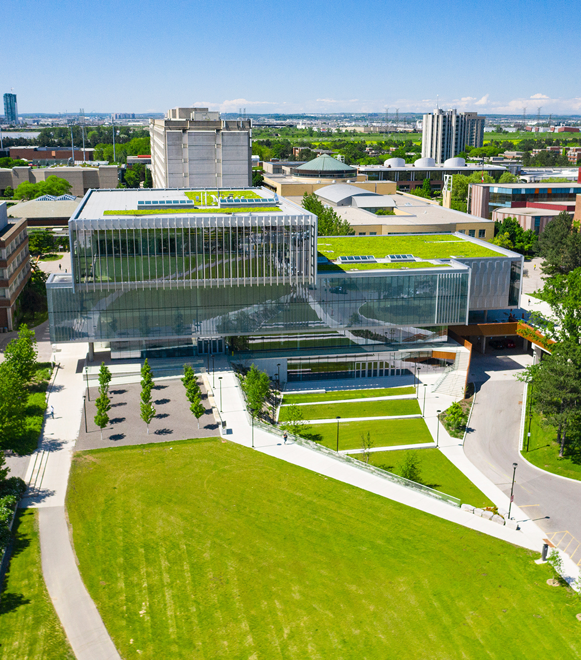

GEOMATICS AT A GLANCE
  Geomatics:
    The discipline concerned with the collection, distribution, storage, analysis, processing, and presentation of geographic data or geographic information [ISO/TC 211].
  Geomatics Engineering:
    An engineering discipline that deals with the acquisition, analysis and management of spatially referenced data that identifies locations.
    Involved in a wide array of information gathering activities that begin with the design and implementation of the data generation (hardware and software) systems themselves, and facilitates both application, research and management activities.
  Career prospects:
    Software/hardware/system development in high tech
    Licensed Land Surveyors
    Specialist in spatial (information) analysis
  Professional bodies:
    Professional Engineers Ontario (PEO)
    Association of Ontario Land Surveyors (AOLS)
    Canadian Board of Examiners for Professional Surveyors (CBEPS)
  Explore local companies:
  Applanix, PCI Geomatics, Teledyne Optech, J.D. Barnes Limited, Cansel
Notes:
This slide was originally included to promote Geomatics. None of the other Engineering majors contain a slide of this sort. Should this slide continue to be included in curriculum updates?

