Slide 1
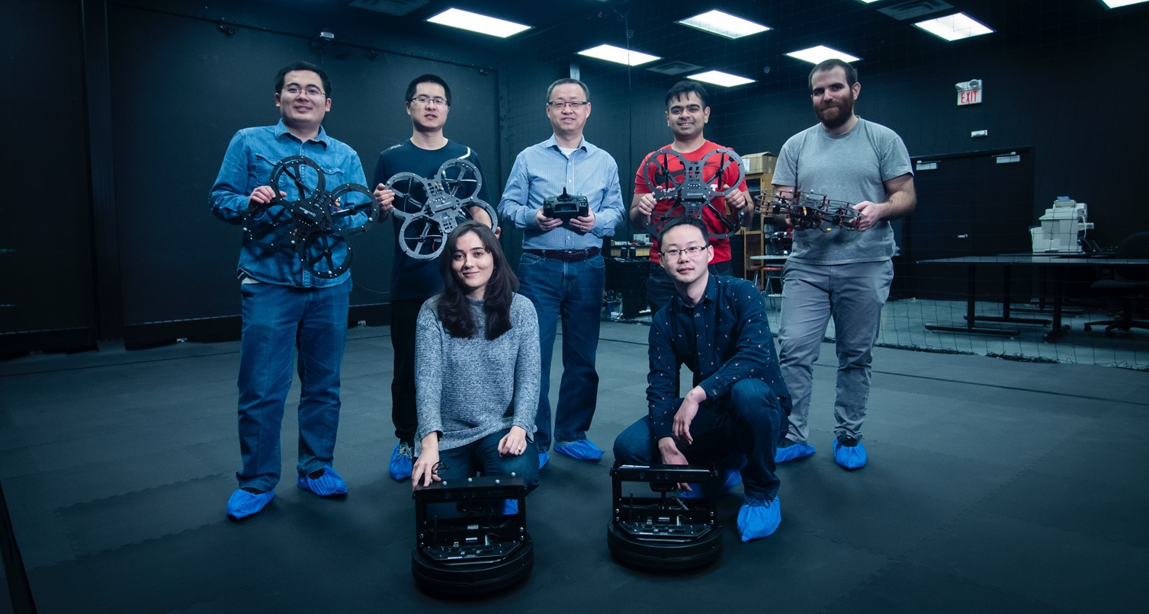
SPACE ENGINEERING
CURRICULUM UPDATES

Slide 2
SPACE ENGINEERING
NEW
Opportunity for Space and Mechanical Engineering Students – Pursue new Mechatronics Certificate alongside your Bachelor of Engineering A unique chance to get involved in cutting-edge space projects is now available exclusively to Space and Mechanical Engineering students. Learn from active researchers, build real-world experience, and be part of high-impact initiatives. What’s in it for you: Work on innovative, hands-on engineering projects Collaborate with experts in space systems and technology Join student teams competing and succeeding on a global stage Build skills that cross disciplines and industries Don't miss this chance to go beyond the classroom and into the future of space. Courses to complete → Mechatronics Certificate

Slide 3
SPACE ENGINEERING
RECAP
Replacement: PHYS 3050 3.00 is replaced with EECS 2200 3.00.
Replacement: PHYS 3150 3.00 is replaced with EECS 2210 3.00.
Replacement: ESSE 2220 3.00 is replaced with EECS 2030 3.00 Section E, Section F, or Section Z.
Students entering 3rd year this Fall/Winter 2024-2025 (i.e., students who entered Fall/Winter 2022-2023 and declared Space Engineering in Fall/Winter 2023-2024): In the 2024-2025 academic year, you will: Enrol in ESSE 4020 3.00 (Fall 2024) and ENG 4550 3.00 (Fall 2024 or Winter 2025), in place of ESSE 3330 3.00 and ESSE 3360 3.00 If ESSE/PHYS 3280 3.00 (Winter 2025) is cancelled, enrol in ESSE 4350 3.00 (Year term) in its place In the 2025-2026 academic year, you will: Enrol in ESSE 3330 3.00 and ESSE 3360 3.00 and possibly ESSE 4350 3.00 (pending PHYS 3280 3.00) The above represents a re-ordering of your 3rd and 4th year courses. Students Graduating February, June, or October 2025 and missing ESSE 3330 3.00 and/or ESSE 3360 3.00: Contact Professor Regina Lee, Undergraduate Program Director, (reginal@yorku.ca) to discuss permission to complete ESSE 4000 3.00/6.00 instead.

Slide 4
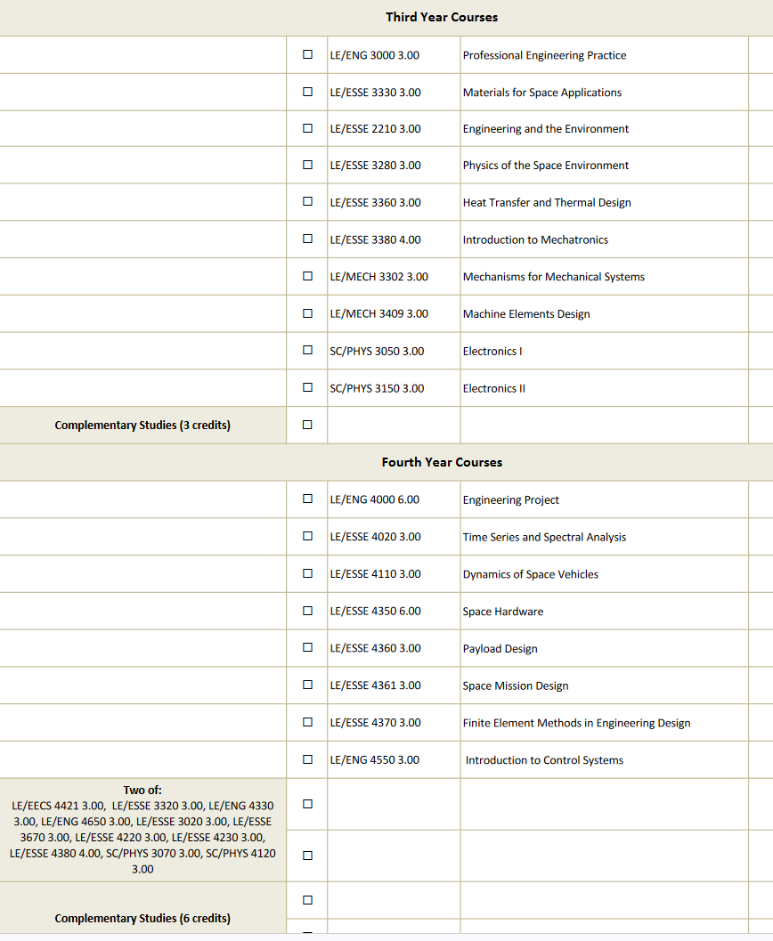
SPACE ENGINEERING
Enrol in the 2025-2026 academic year / Move to 4th year
Enrol in the 2025-2026 academic year / Move to 4th year
Swap 3280 with 4350 if 3280 is not offered in the 2024-2025 academic year
Enrol in the 2024-2025 academic year / Complete in 3rd year
Enrol in the 2024-2025 academic year / Complete in 3rd year

Slide 5
SPACE ENGINEERING
UPDATED
For students following the 2022-2023 Academic Calendar: ESSE 3380 4.00 “Introduction to Mechatronics”, a major requirement, is not currently offered Approved course substitute: Until ESSE 3380 4.00 is offered, students must complete PHYS 2030 3.00 instead ESSE 4380 4.00 “Mechatronic Systems and Design“, a technical elective option, is not currently offered Students may select from any other available technical electives listed in the Academic Calendar
For students following the 2022-2023 Academic Calendar: MECH 3409 3.00 “Machine Elements Design”, a major requirement, is open for Space Engineering students Students who were unable to complete MECH 3409 3.00 in Fall/Winter 2023-2024 were approved to complete PHYS 3250 3.00 instead

Slide 6
SPACE ENGINEERING
RECAP
Subject code changes: ENG 3330 3.00 is now ESSE 3330 3.00 ENG 4350 6.00 is now ESSE 4350 6.00 ENG 3320 3.00 is now ESSE 3320 3.00 PHYS 4110 3.00 is now ESSE 4110 3.00
“Two of” Technical Electives: Students are required to complete 6.00 credits of technical electives from a “two of” list in their Academic Calendar. Students may choose from courses listed in their original Academic Calendar or they may select courses from a more recent Academic Calendar. For example: For example, the 2016-2017 Academic Calendar states: Two of: LE/EECS 4421 3.00, LE/ENG 3320 3.00, LE/ENG 4330 3.00, LE/ESSE 3020 3.00; LE/ESSE 4220 3.00, LE/ESSE 4230 3.00, LE/ESSE 4610 3.00, SC/PHYS 3070 3.00, SC/PHYS 4120 3.00. Whereas the 2022-2023 Academic Calendar states: Two of: LE/EECS 4421 3.00, LE/ESSE 3320 3.00, LE/ENG 4330 3.00, LE/ENG 4650 3.00, LE/ESSE 3020 3.00; LE/ESSE 3670 3.00, LE/ESSE 4220 3.00, LE/ESSE 4230 3.00, SC/PHYS 3070 3.00, SC/PHYS 4120 3.00, LE/ESSE 4380 4.00. For students following the 2021-2022 Academic Calendar and prior: ESSE 3380 4.00 and MECH 3409 3.00, when offered and available for Space Engineering students, can also count towards the “Two of” technical electives.

Slide 7
SPACE ENGINEERING
RECAP
No longer offered: ESSE 2360 3.00 and ESSE 3340 3.00 will no longer be offered effective Fall/Winter 2019/2020
Replacement: ENG 2003 3.00 may be taken instead of ESSE 2360 3.00
Replacement: MECH 3302 3.00 may be taken instead of ESSE 3340 3.00
Replacement: ESSE 4610 3.00 was replaced with ESSE 3670 3.00
Students following the 2014-2015 or 2015-2016 or 2016-2017 or 2017-2018 Academic Calendars: EECS 2031 3.00 is listed as a degree requirement: Previous approved course substitution: Take EECS 1541 3.00 to satisfy your EECS 2031 3.00 degree requirement. Approved course substitution effective Fall 2019: If EECS 1541 3.00 was not completed by Winter 2019, you must complete ESSE 2220 3.00 (not EECS 1541 3.00) to satisfy the EECS 2031 3.00 degree requirement. Students following the 2018-2019 Academic Calendar: While ESSE 2220 3.00 is listed as a degree requirement, it was not offered in the Fall/Winter 2018-2019 academic session. Approved course substitution: Students requiring ESSE 2220 3.00 were approved to complete EECS 2031 3.00 E/Z instead in the Fall/Winter 2018-2019 academic session only.

